Slide 1
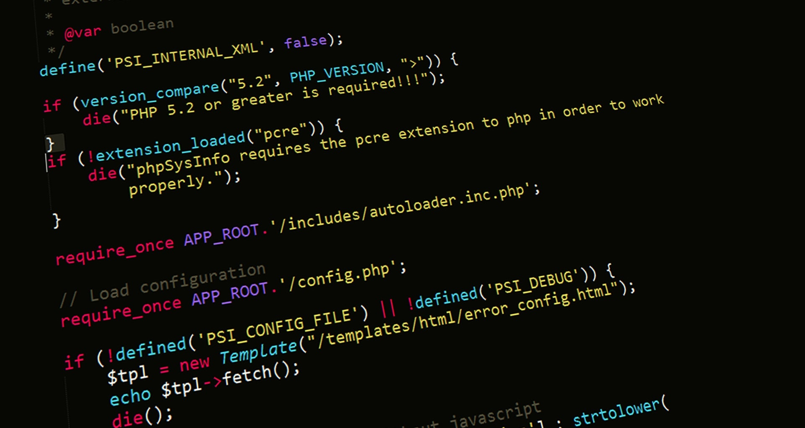
Server-Side Web Programming (COMP10260)
WEB architecture – Part II

Slide 2
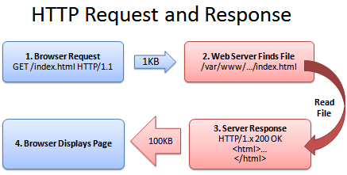
The story so far…
HTTP works via a series of requests and responses.
HTTP requests primarily employ one of two request methods:
GET –Here the user can only specify a path. This can be used to send data to the server by use of a ‘? Followed by a list of name/value pairs separated by an equals sign. Multiple fields are separated by using the ‘&’ character.
E.g.: GET /index.html?user=larry&pass=xiao POST – This allows the user to specify a path and provide data in the body of the HTTP request.
This Photo by Unknown Author is licensed under CC BY-SA

Slide 3
The story so far…
HTTP Responses also contain a header and a body.
The header contains the response code telling you if the request was successful. It also contains the content-type which tells the browser what kind of data is being returned. So the browser can decide what to do with it! HTTP/1.1 200 OK Content-Type: text/html
The body is simply the data was requested i.e., HTML, PDF file, etc..
This Photo by Unknown Author is licensed under CC BY-SA

Slide 4
Dynamic HTML

Slide 5

DYNAMIC HTML (Client-Side)
In 1995, as an effort to make HTML pages more interactive Netscape Inc. created a programming language that ran inside the browser which they called JavaScript.
The idea was that a browser could make a HTTP GET request to a web server and the server could respond with HTML as well as a program written in this new language.
The program would run on the user's machine which would allow some things to be done more efficiently. For example, if you had a form field that only allowed numbers. The previous way to validate this input was to wait until the user submitted the form and then have the server respond with an error message.

Slide 6
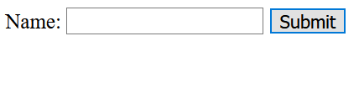
DYNAMIC HTML (CLIENT SIDE)
HTML + Javascript
RESULTING WEB PAGE
<!DOCTYPE html> <html><body><form name="Form1" action="/action_page.php" onsubmit="if (document.forms['Form1']['name'].value=='') { alert('I need a name');return false;}" > Name: <input type="text" name="name"> <input type="submit" value="Submit" > </form></body></html>

Slide 7
DYNAMIC HTML (CLIENT SIDE)
Closer look at the Javascript in the form TAG
<form name="Form1" action="/action_page.php" onsubmit=" if (document.forms['Form1']['name'].value == "" ) { alert('I need a name’); return false; } " >

Slide 8
Server Side Scripting in PHP

Slide 9
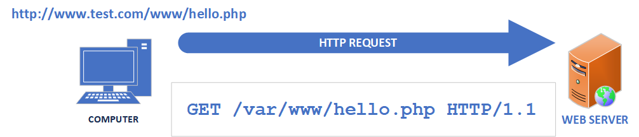
Web Architecture: DYNAMIC HTML (Server Side)
The focus of this course are the development and architecture of Server-side Dynamic pages. In theory these are simple. They alter the HTTP paradigm so that instead of having the HTTP Request tell the server to retrieve a file. It is now telling it to run a program.
The program itself can be written in one of many programming languages (PHP, Python, Ruby, Java, C#).
The output of the program is an HTTP Response. This can include HTTP headers and HTML.

Slide 10
DYNAMIC HTML (Server Side)
Historically (and still today somewhat) the part of the Web Server which invokes our server-side script was known as a Common Gateway Interface or CGI. Because of this, some texts still refer to Server-side scripts as “CGI scripts”.
While the server-side scripts open up a significant number of new possibilities for web applications. They do not require any real changes to the HTTP Request. All the magic is done on the web server.

Slide 11
HTTP Request (Server-side script)
GET /var/www/test.php HTTP/1.1
User-Agent: Mozilla/4.0 (compatible; MSIE5.01; Windows NT)
Host: www.test.com
Accept-Language: en-us
Accept-Encoding: gzip, deflate
Connection: Keep-Alive
HTTP REQUEST METHOD (VERB)
USER INPUT
BROWSER INFORMATION

Slide 12
DYNAMIC HTML (SERVER SIDE)
PHP CODE
RESULTING HTML
<?PHP
$message = "This HTML is generated by PHP!";
echo "<!DOCTYPE html><html><body><h2>PHP Demonstration</h2>
<div style='background-color:lightgrey;border:15px solid green;'>".$message."</div></body></html>";?>
<!DOCTYPE html> <html><body> <h2>PHP Demonstration</h2> <div style='background-color:lightgrey;border:15px solid green;’> This HTML is generated by PHP! </div> </body></html>

Slide 13
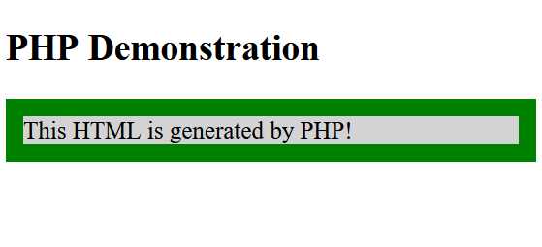
DYNAMIC HTML (SERVER SIDE)
HTML
RESULTING WEB PAGE
<!DOCTYPE html> <html><body> <h2>PHP Demonstration</h2> <div style='background-color:lightgrey;border:15px solid green;’> This HTML is generated by PHP! </div> </body></html>

Slide 14
Writing a simple HTML form script
One of the early ways of using a server-side script is to use them as a target for an HTML form.
HTML Forms were introduced in 1993 as a way of transferring information to server-side (CGI) scripts.
In their simplest implementation HTML Forms, use exactly two tags to achieve this effect. The first tag is the <FORM></FORM> tags. This designates the portion of the web page that contains the form and <INPUT /> tags.
These create the fields that the user can enter their data into.
<HTML> <BODY> <FORM action="test.php" /> <INPUT type="text" name="username" /><BR /> <INPUT type="text" name="password"/><BR /> <INPUT type="submit" /> </FORM> </BODY>

Slide 15
Writing a simple HTML form script
As you can see in the example here. The <FORM> tag contains a parameter “action”. This is the location of the server-side script you would like to send the form data to.
The <INPUT> tags make up the fields. Two of these are text fields. There are approximately 22 currently defined input types.
Of special note is the “submit” type. When rendered by the browser this tag creates a button on the screen which, when clicked causes the data in the fields to be collected into a HTTP Request and sent to our server-side script (test.php in this case)
<HTML> <BODY> <FORM action="test.php" /> <INPUT type="text" name="username" /><BR /> <INPUT type="text" name="password"/><BR /> <INPUT type="submit" /> </FORM> </BODY>

Slide 16
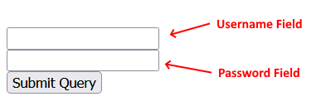
Writing a simple HTML form script
HTML
RESULTING Web Page
<HTML> <BODY> <FORM action="test.php" /> <INPUT type="text" name="username" /><BR /> <INPUT type="text" name="password"/><BR /> <INPUT type="submit" /> </FORM> </BODY>

Slide 17


Types of Input Tags
Code | Description | Appearance
<INPUT type="text" name="field" value="Test" /> | Allows a user to enter any text. A “value” parameter can be added to pre-populate the field with a value.
<INPUT type="button" name="field" value="Click Here!" /> | Creates a button on the screen. The button will contain the text in the “value” parameter. Buttons have no functionality of their own. When a form containing the button is submitted. The field name will be passed to the server containing the contents of the “value” parameter.
<INPUT type="checkbox" name="field" value="things" checked/> | Creates a small box that can be toggled on or off by clicking on it. When “on”, submitting the form will pass a field containing the value in the “value” parameter. Otherwise, the field will not be passed. Checkboxes can be defaulted to “on” by specifying the parameter “checked”

Slide 18
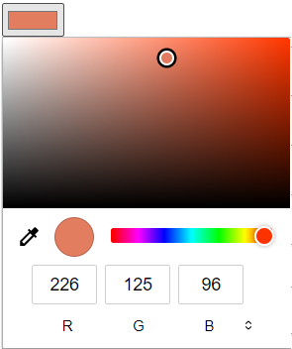

Types of Input Tags
Code | Description | Appearance
<INPUT type="color" name="field" value="#E27D60"/> | In most browsers this creates a “colour picker” which allows the user to choose a color. When submitted, the field contains a 7-character RGB code starting with a “#”. E.g., #E27D60. The “value” parameter may be used to set a default colour.
<INPUT type="email" name="field" value='test@gmail.com’ /> | Creates a text field on the screen. When the form is submitted the browser checks to see if what you entered is in form of “<some text>@<some other text>”. If not, the submit will fail and the user will be notified. There are input types for “url” and “number’ which have similar functionality.

Slide 19
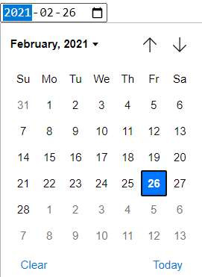

Types of Input Tags
Code | Description | Appearance
<INPUT type="date" name="field" value="2021-02-26" /> | In most browsers this creates a “date picker” which allows the user to choose a date (but not the time) from a calendar. The picker will allow the user to enter a date using whatever their localized format is (e.g., MM/DD/YYYY). When submitted, the field contains a date in the format YYYY-MM-DD. The field can be pre-populated with the “value” parameter. It can also use the “max” and “min” parameters to limit entry to a date range.
<INPUT type="password" name="field" value="testing/> | Creates a text field on the screen. As you type, the letters are replaced with bullet points. The idea being that this is a security measure to keep people from seeing your password as you type it. Parameters “maxlength” and “minlength” can be specified as well.

Slide 20


Types of Input Tags
Code | Description | Appearance
<INPUT type="range" name="field" value=20 min=0 max=100 /> | Creates a slider on the screen that can be used to specify a value between the “min” and “max” parameters. The “value” parameter can be used to select a default position. If not specified, the control is set to the midpoint between “min” and “max”. If “min” and “max” are not provided they default to “0” and “100” respectively.
<INPUT type="submit" name="submitted" value="Click Here!" /> | Causes the browser to collect the data in this form into an HTTP Request and send it to the script mentioned in the “action” parameter. The HTTP Request will, in addition to all that data contain a field with the name of this button which contains the data from its “value” parameter.

Slide 21

Types of Input Tags
Code | Description | Appearance
<INPUT type="radio" name="field" value="A" CHECKED/><INPUT type="radio" name="field" value="B" /> | Creates a series of circular clickable buttons which are related in function. Clicking on one button turns “off” all the other buttons. When submitted, only the value from the selected button ends up in the HTTP Request. In order to work, radio buttons must all have exactly the same name. If no button is selected the field is not included. The “checked” attribute can be included to allow a button to be on by default.
NOTE: ALL input tags of all types require a name to function. If a field has no name. The data isn’t sent.

Slide 22
Form Methods
As we have mentioned above submitting a form creates a HTTP Request. However, we haven’t discussed what kind of request it generates.
By default, it creates a “GET” request. We can also tell it to use some other verb by use of the “method” parameter.
So, what’s the difference?
<HTML> <BODY> <FORM action="test.php" method="POST" /> <INPUT type="text" name="username" /><BR /> <INPUT type="text" name="password"/><BR /> <INPUT type="submit" /> </FORM> </BODY>

Slide 23
HTTP Request - GET
GET /test.php?username=MyUsername&password=MyPassword HTTP/1.1 Host: 172.16.0.240 User-Agent: Mozilla/5.0 (Windows NT 10.0; Win64; x64; rv:101.0) Gecko/20100101 Firefox/101.0 Accept: text/html;q=0.9,image/avif,image/webp,*/*;q=0.8 Accept-Language: en-US,en;q=0.5 Accept-Encoding: gzip, deflate Connection: keep-alive

Slide 24
HTTP Request - POST
POST /test.php HTTP/1.1 Host: 172.16.0.240 User-Agent: Mozilla/5.0 (Windows NT 10.0; Win64; x64; rv:101.0) Gecko/20100101 Firefox/101.0 Accept: text/html;q=0.9,image/avif,image/webp,*/*;q=0.8 Accept-Language: en-US,en;q=0.5 Accept-Encoding: gzip, deflate Content-Type: application/x-www-form-urlencoded Content-Length: 39 Connection: keep-alive (there are two <CR><LF> sequences here)
username=MyUsername&password=MyPassword
(there is one <CR><LF> sequence here)

Slide 25
GET vs. POST
As you can see the GET request places the form fields in the URL line and the POST request places them in the body of the request. When choosing which type of request to use it’s important to know the strengths and weaknesses of each:
Advantages of Using a GET request:
Can be cached.
Can be bookmarked.
Can be encoded in a URL.
Human-readable
Advantages of using a POST request:
Can’t be easily seen by anyone observing the browser URL bar.
The information is not, by default cached. So, nobody can view sensitive information like your login credentials in your browser history..
For all intents and purposes, it has no practical maximum length (A GET is limited to about 2048 bytes).

Slide 26
Multiple HTML Forms
A web page can have multiple forms on it. Each one has its own action parameter and can submit to a different script (or the same one). However, they can not be nested!
Each form should have its own “submit” input element. The HTTP request generated by clicking on “submit” does not contain any information about the form. So, if they all submit to the same script. The script must differentiate which button was pressed.
One way of doing this is to give the submit buttons different names (or the same name with different values).

Slide 27
HTML Forms in PHP

Slide 28
HTML forms in PHP
Here’s our login form again (a copy of this can be downloaded from Canvas as login_get.html.You can just drop it into your C:\xampp\htdocs directory)
As we noted earlier, we can use this to send form data to a PHP script simply by placing the script name in the action parameter.
<HTML> <BODY> <FORM action="myapp.php" method="GET" /> <INPUT type="text" name="username" /><BR /> <INPUT type="text" name="password"/><BR /> <INPUT type="submit" /></FORM> </BODY>

Slide 29
Working with HTML forms in PHP
PHP makes it pretty easy to get data from the user. Everything you need is in arrays.
When data is passed on the URL line such as http://myserver.com/myapp.php?username=xxxx&password=yyy
PHP parses this and puts the values in an array called $_GET
So, how do we find the data?
Remember when we said that arrays could have an index that wasn’t a number?
That’s exactly what we do here!
<?PHP
$sent_password = $_GET['password’]; $sent_username = $_GET['username'];
printf ("%s %s",$sent_username,$sent_password);
?>

Slide 30
FORMS - GET
As you can see all we need to do is use a string as the index into the array.
If the string matches one of the values passed in the URL, then it shows up in this array!
(A copy of this can be found on Canvas as myapp.php)
<?PHP
$sent_password = $_GET['password’]; $sent_username = $_GET['username'];
printf ("%s %s",$sent_username,$sent_password);
?>

Slide 31
FORMS - POST
When you use a web form to POST data to a PHP script. It works in a nearly identical way.
This time our variable is called $_POST
The index this time is the name defined in the HTML form field tag.
<HTML><BODY><FORM method='POST'> <input type='text' name='username' /> <input type='text' name='password' /> <input type='submit' value='login' /> </FORM></BODY></HTML> <?PHP $sent_password = $_POST['password']; $sent_username = $_POST['username']; echo $sent_password;
?>

Slide 32
FORMS - POST
As you can see, we’ve done a few things differently this time.
We have combined the HTML and the PHP into the same file.
We have also omitted the action parameter. This will cause the form to submit to the same URL it loaded from.
This is sometimes called a self-submitting form.
(You can find a copy of this on Canvas as self_submit.php)
<HTML><BODY><FORM method='POST'> <input type='text' name='username' /> <input type='text' name='password' /> <input type='submit' value='login' /> </FORM></BODY></HTML> <?PHP $sent_password = $_POST['password']; $sent_username = $_POST['username']; echo $sent_password;
?>

Slide 33
Notes on Using $_GET/$_POST
Regardless of the kind of data being sent in the form field. $_GET and $_POST both convert the data into a string. If you need to make sure that form contains a number. PHP provides the is_numeric() function.
As we mentioned earlier some conditions cause a form field not to be sent. When this happens attempting to access an index with that name in the $_GET or $_POST arrays will cause an error.
<HTML><BODY><FORM method='POST’> <input type='text' name='username’ /> <input type='text' name='password’ /> <input type='submit' value='login’ /> </FORM></BODY></HTML><?PHP $sent_password = isset($_POST['password'])?$_POST['password']:""; $sent_username = isset($_POST['username'])?$_POST['username']:""; echo $sent_password; ?>

Slide 34
Notes on Using $_GET/$_POST
Because of this we frequently need to check to see if the index exists before you try and use it. To do so people often use the isset() function.
Passing isset() a variable will tell you if it exists or not. You can combine this with the ‘?’ operator to make sure a variable always has a value.
<HTML><BODY><FORM method='POST’> <input type='text' name='username’ /> <input type='text' name='password’ /> <input type='submit' value='login’ /> </FORM></BODY></HTML><?PHP $sent_password = isset($_POST['password'])?$_POST['password']:""; $sent_username = isset($_POST['username'])?$_POST['username']:""; echo $sent_password; ?>

Slide 35
Getting Headers and other data.
As we have just learned the CGI sends us the HTML form data – for both GET and POST Requests. In addition, it gives us access to just about all the information in the HTTP Request.
For example, if you want to know if the browser has set the HTTP “Connection” header to “keep alive”. You can query $_SERVER['HTTP_CONNECTION']. All the HTTP Request headers exist in this array, but many are prefixed with “HTTP_”. E.g., If we want to check the User-Agent string we need to look at $_SERVER['HTTP_USER_AGENT’]
Server also gives you a lot of other information. For example, $_SERVER['SERVER_ADDR'] supplies the IP address of the server.

Slide 36
Manipulating HTTP Headers
As you saw in your Lab, PHP makes it easy to create a web page. Anything PHP outputs gets sent back to the requestor’s web browser.
PHP also allows us to manipulate the HTTP Response headers. This should come as no surprise. Since, as we’ve seen the headers and the content are all part of the same HTTP Response.
PHP does this using a function called header()
<?php header("Location: http://www.apple.com") ?>

Slide 37
Manipulating HTTP Headers
The HTTP Response header that we are manipulating here is “Location”. It allows us to tell a web browser to change its location to a different page.
In the example below any browser invoking this script would receive a HTTP Response containing Location: http://www.apple.com. Upon receiving this, the browser would attempt to load the indicated web page.
This header is often used when a page has moved.
<?php header("Location: http://www.apple.com") ?>

Slide 38
Manipulating HTTP Headers
It’s worth noting that since everything that PHP outputs is placed into the body of a HTTP Response. Any use of “header” must come before any “echo” or “print” statement. So, the following snippet will throw an error.
But this statement will not!
<?php echo "hello"; header("Location: http://www.apple.com"); ?>
<?php header("Location: http://www.apple.com"); echo "hello";?>

Slide 39
Form Architecture
A standard configuration for HTML forms is to have the form either exist as a raw HTML document or generated by a PHP script.
In either case, the user would point their browser to the location of that file. The server would respond with the HTML data. Which the browser would render on the screen as a HTML form.
The user would then input their data and click the “submit” button which creates a HTTP Request and sends it to a different script to be processed.

Slide 40
Form Architecture
As we saw earlier, we can omit the action parameter in the form tag to create a self-submitting form.
Another way of accomplishing this is inserting the name and or URL of our PHP script into the form HTML programmatically by using the $_SERVER['PHP_SELF'] or $_SERVER['REQUEST_URI']
'PHP_SELF' - returns the filename of the script currently being executed. 'REQUEST_URI' – returns the URL used to access this script.
So, we could replace our form tag with something like: <FORM action="<?=$_SERVER['PHP_SELF']?>" method="POST" />

Slide 41
Media References
Read the following PHP manual pages. There are important details in them which could show up in quizzes.
$_GET : https://www.php.net/manual/en/reserved.variables.get $_POST : https://www.php.net/manual/en/reserved.variables.post isset : https://www.php.net/manual/en/function.isset $_SERVER: https://www.php.net/manual/en/reserved.variables.server.php

